Slide 1

THE BEST PLACE
Capstone Project Final

Slide 2
Introduction
Popularity of Japanese culture and food leading to entrepreneurs moving there.
Increasing cuisines all over the world.
Need for entrepreneurs to select the right place to start their business.
Need for a recommender system for entrepreneurs to kickstart their business for good.

Slide 3
Problem statement
To find the optimal location for a budding entrepreneur in Toronto to open a Japanese restaurant, considering the circumstances where:
There are already few restaurants out in the streets.
And also where one can get the maximum business without going down in loss.

Slide 4
Data acquisition
Data for the neighbourhood areas was scraped from the Wikipedia page with the link: https://en.wikipedia.org/wiki/List_of_postal_codes_of_Canada:_M
Data of the longitude and latitude is taken from the Geocoder package with the link: http://cocl.us/Geospatial_data
Further the data for venues was taken from the foursquare API.

Slide 5
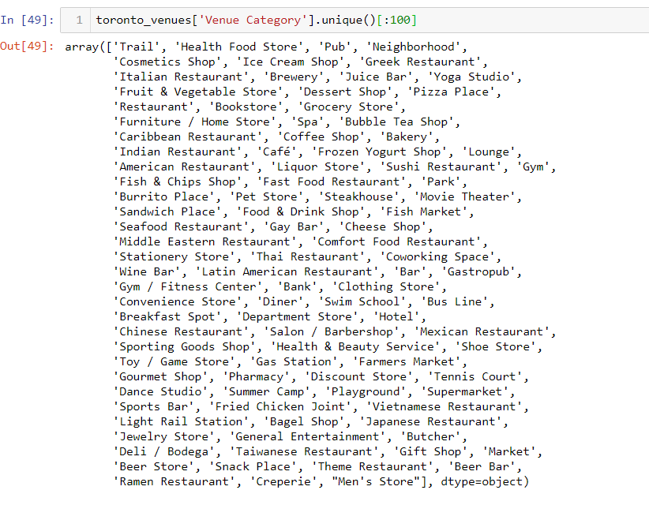
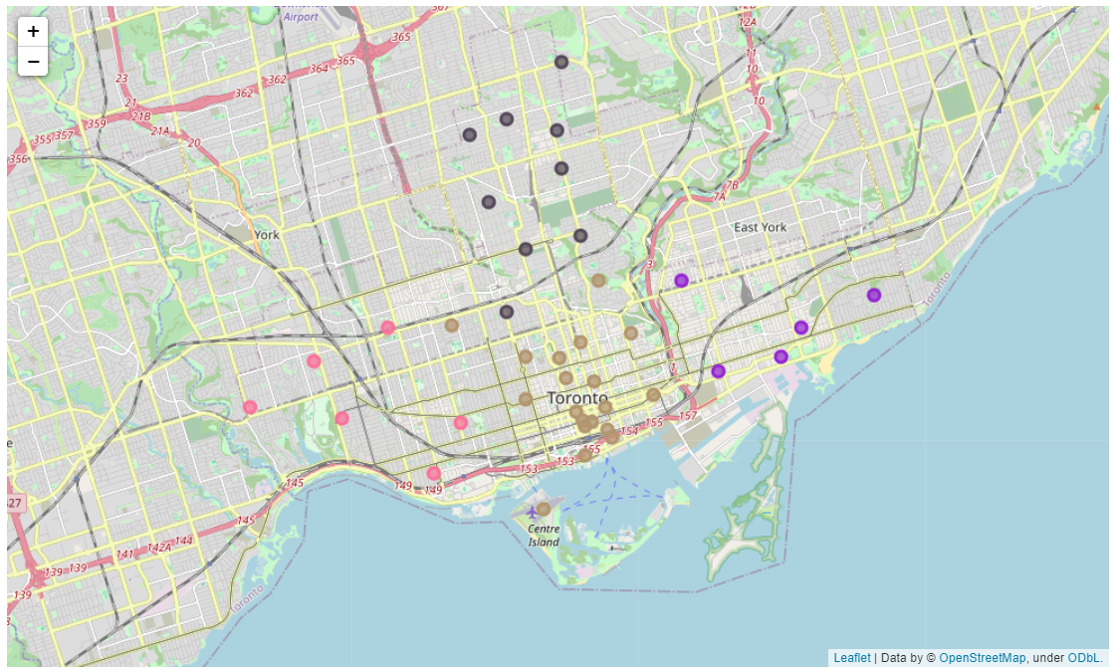

Slide 6
Methodology
The data scraped is merged with the venues using the foursquare API.
Then specifically it is grouped into the one with Japanese restaurant according to the neighbourhoods.
Finally, K-means algorithm was used to cluster these venues accordingly.

Slide 7
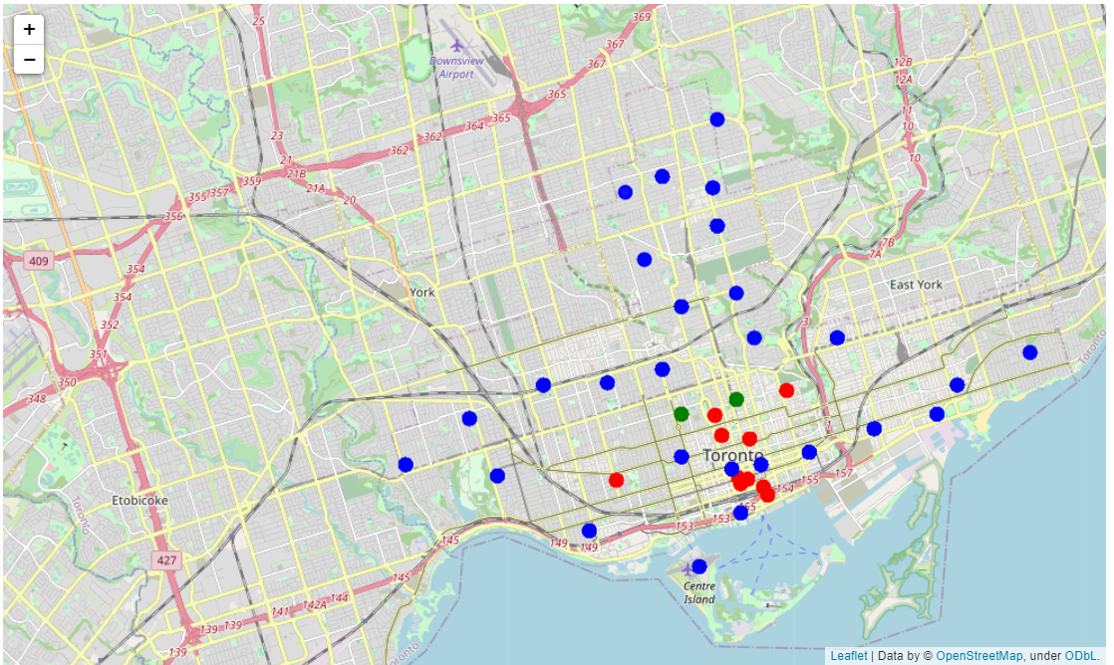
Results
The green one represents cluster 1, with a significantly less restaurants.
The blue one represents cluster 0, with highest number of restaurants.
At last the red one represents cluster 2, with somewhere in the middle of the above two.

Slide 8
Conclusion
Most of the Japanese restaurants are in Cluster 0, which is around : Garden city, Ryerson, Underground city, Cabbagetown, Central Bay street, Berczy park and Victoria hotel.
And the least are in cluster 1, which is around : St. James town, Adelaide, Toronto island, Grange park and Chinatown.
So it will be beneficial for the new entrepreneurs to set up restaurants in the Cluster 1, because there will be less competition and more profit in that location.

